Slide 1

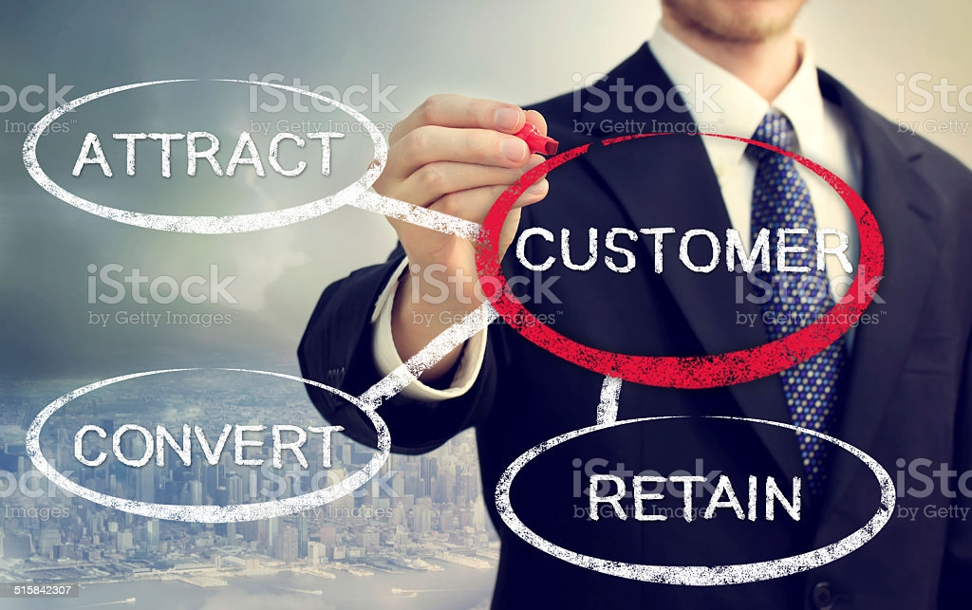
E-retail factors for customer activation and retention

Slide 2
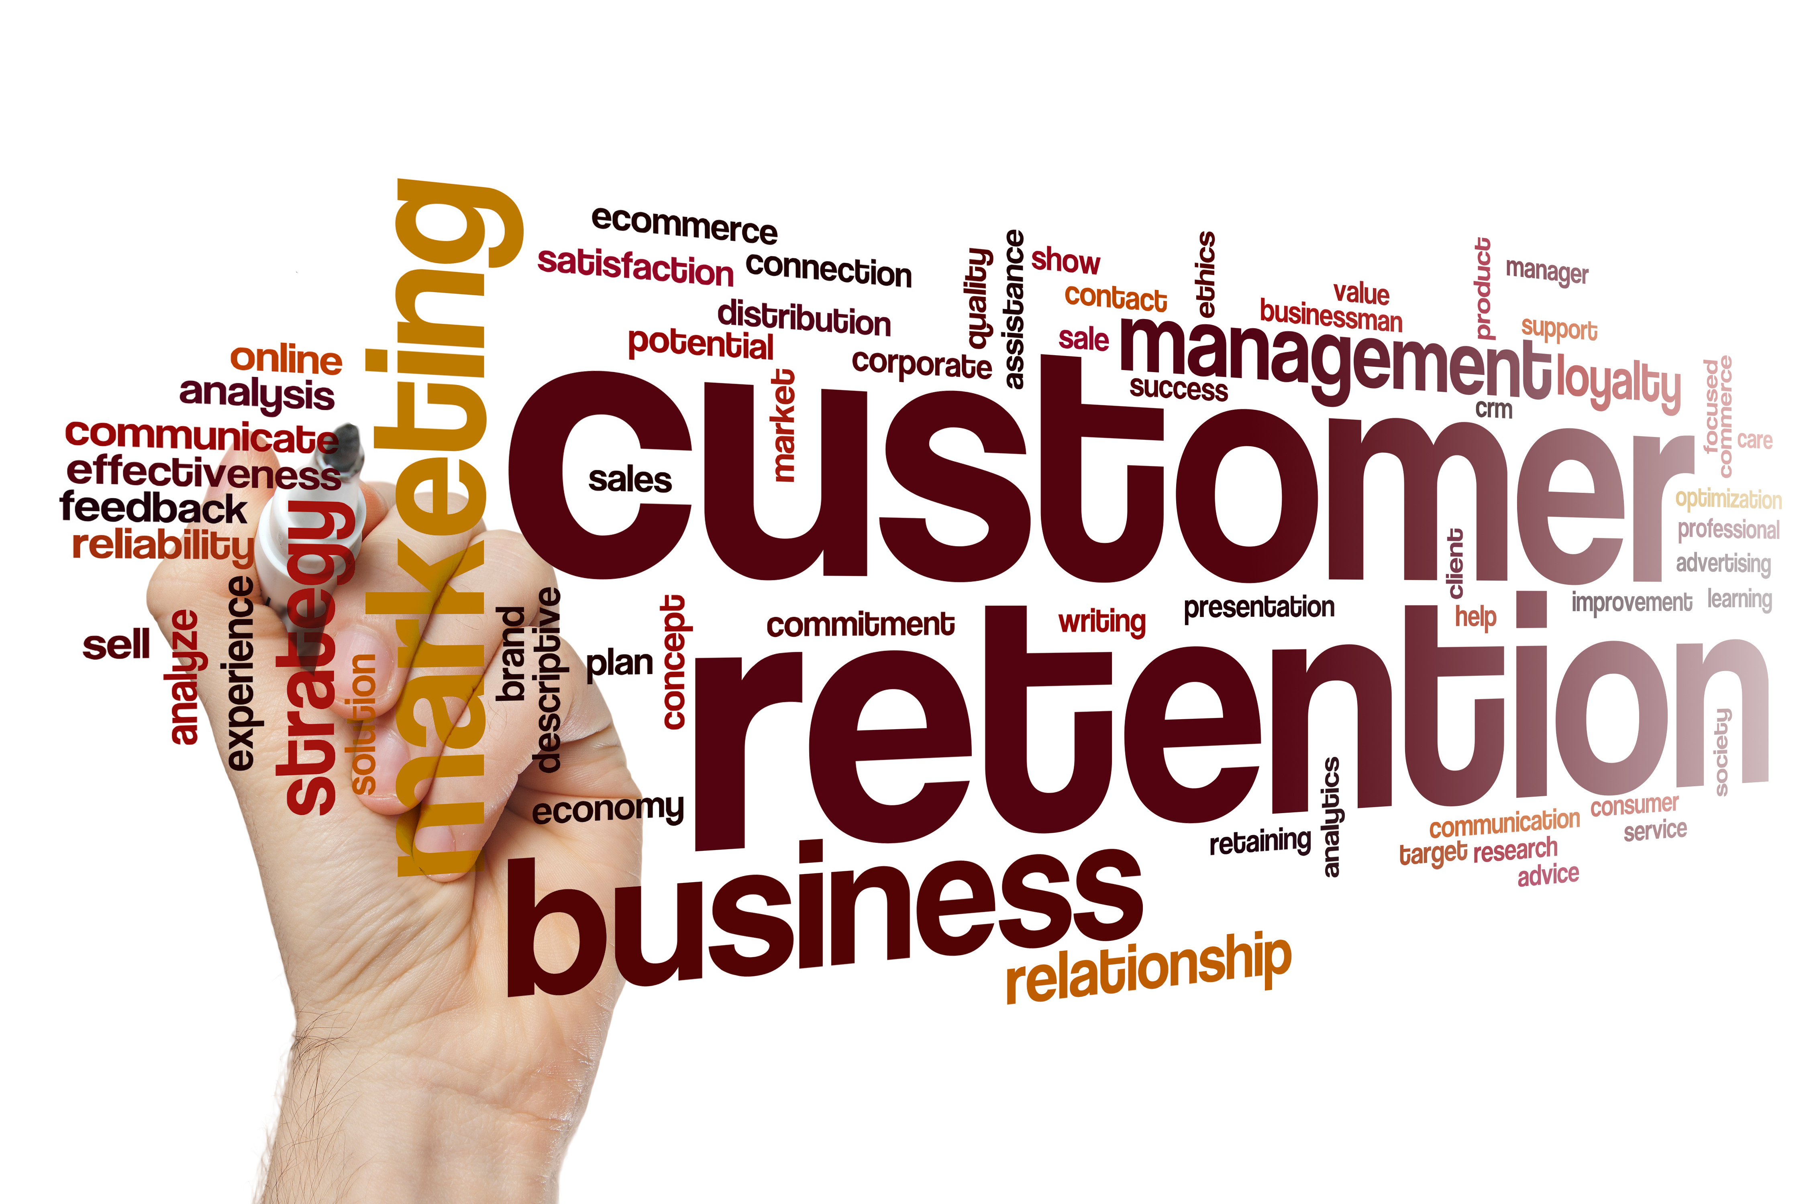
Customer Retention has emerged as one of the most important factors that guarantee the success of online store.

Slide 3
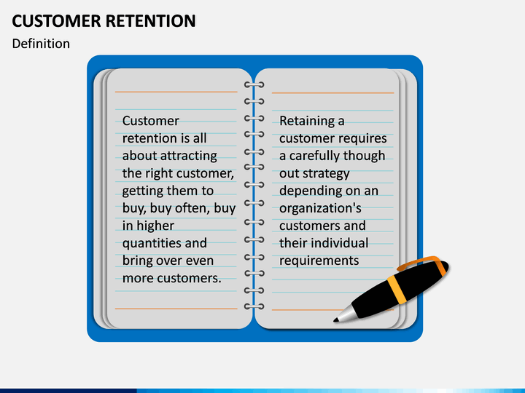
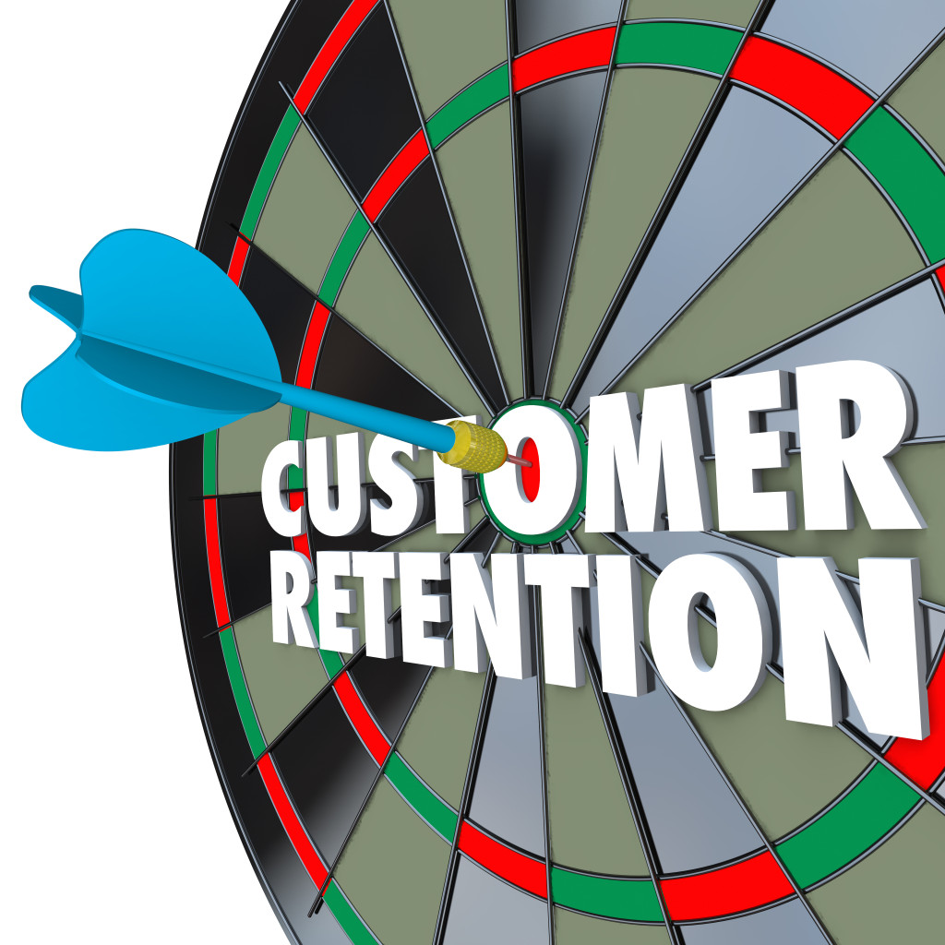
Customer Retention
What is Customer Retention?
Customer retention is the ability to keep customers coming to your store or website to create repeat business.
Knowing customer behavior
Customer expectation of future use
Keeping customers active with tools
Strong CRM system

Slide 4
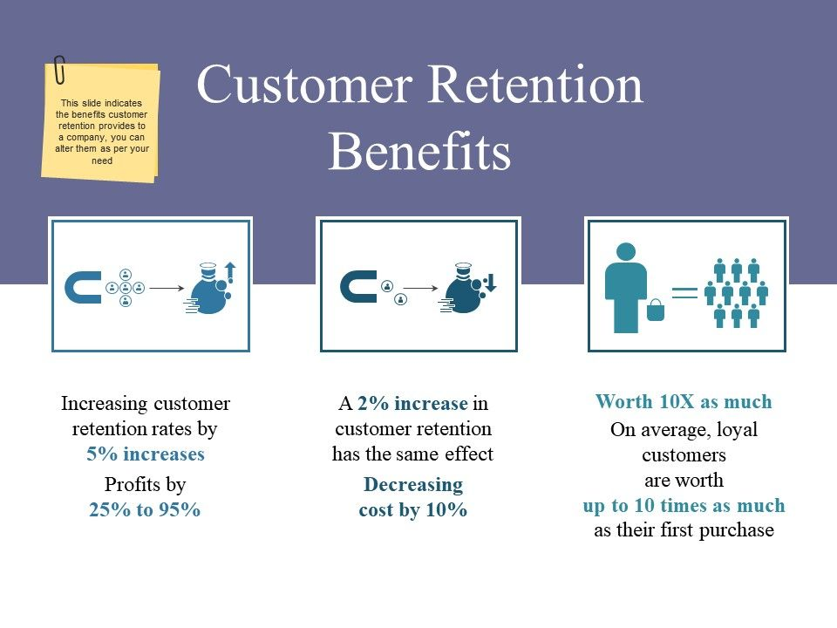
Need of customer Retention
Less spending on customer acquisition : Acquiring a new customer can be up to five times more expensive than retaining an existing one.
Increased profits : An increase in client retention by 5% can enhance profits by over 25% .
Improved online reputation : Over 37% of customers will only post online reviews if they are “extremely satisfied”.
Positive Reviews : The longer customers stay with a company, the more business, positive reviews, and they bring word of mouth advertising.

Slide 5
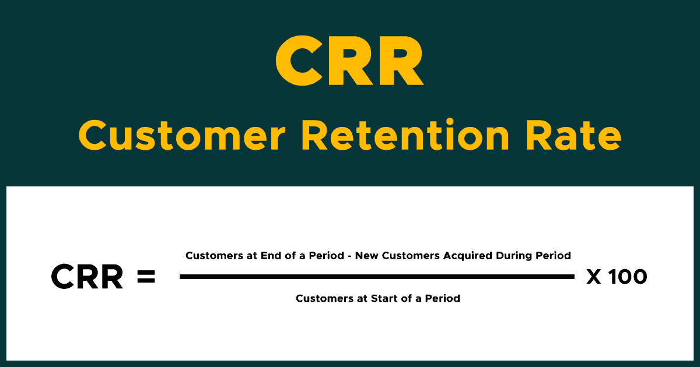
.
Customer retention benefits:
Customer loyalty: Current customers already trust your brand, so it is easier to make them repeat customers.
Brand ambassadorship: Loyal customers act as vehicles of brand sentiment and customer acquisition via word-of-mouth marketing (e.g. testimonials and referrals).
Cost savings: Repeat customers trust the brand, so there is no need for an extensive retention marketing strategy or advertising spend (versus new customers that require extensive spend to create brand sentiment and trust).
Improved profitability: Satisfying new and repeat customers sustains loyalty and increases the bottom line. In fact, happy customers are prone to make repeat purchases over a longer period of time.

Slide 6
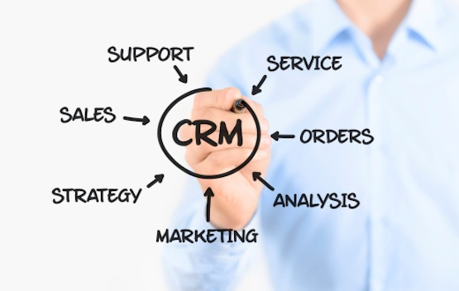
Customer Relationship Management
CRM is a business strategy that commits an organization to be customer centric with intent to deliver profitable value by understanding and anticipating customer needs CRM community.
CRM consists of a set of enabling technologies that centralize customer data and provide an infrastructure that facilitates the profitable delivery of value CRM community.

Slide 7

Five major factors that contributed to the success of an e-commerce store have been identified as:
system quality
information quality
service quality
trust
Net benefit

Slide 8
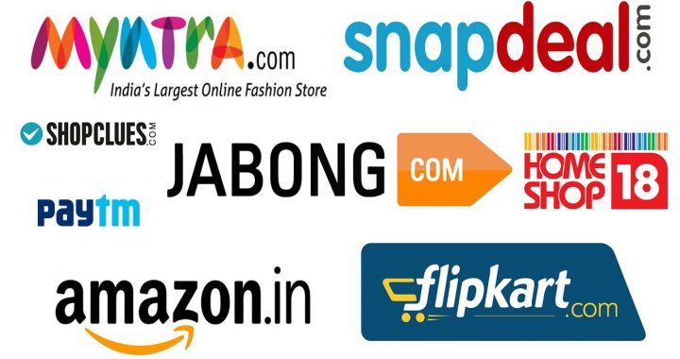
How a Modern Database Works
Customer Transactions
Marketing Campaigns
Marketing Staff -Access By Web
Analytic &
Campaign
Software
Marketing
Database
Inputs from retail, phone, web
Modeling &
Analytics
Data Cleaning
Standardization
Appended
Data
Website

Slide 9
Why retention is important: For long term loyal customers
Buy more per year
Buy higher priced options
Buy more often
Are less price sensitive
Are less costly to serve
Are more loyal
Have a higher lifetime value

Slide 10
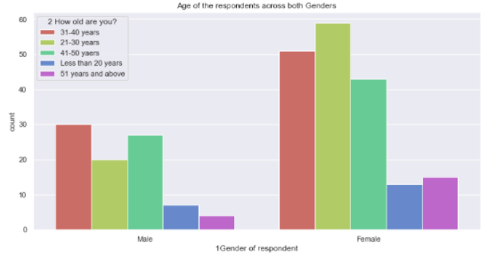
Visualization (Using sns count plot))
The dataset appears to have approximately 67% of Female respondents, approximately 32 % of Male respondents
we simply assume that Female purchase more online than Male,This dataset has only 269 records and it's merely difficult to conclude the majority in general
Female made more purchases than Male customers.

Slide 11
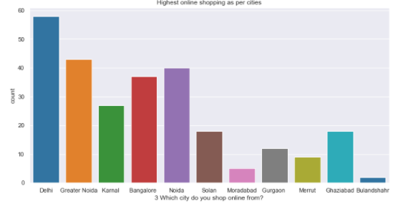
Observe if there is any relationship between online purchases and the city. We can see that the respondents in this case appear to be majorly from "Delhi" as it has highest online purchases followed by "Greater Noida" , "Noida" and "Bangalore" seem to have high traffic in online purchases

Slide 12
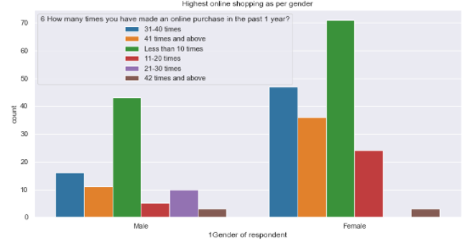
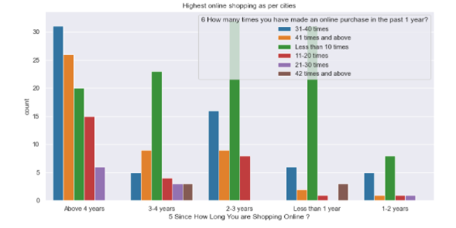
Relationship between number of purchases made from online sources products at least in 1 the last 1 year.

Slide 13
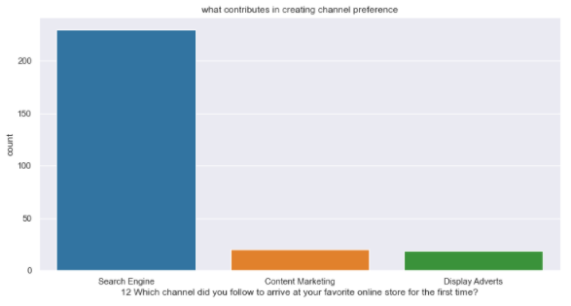
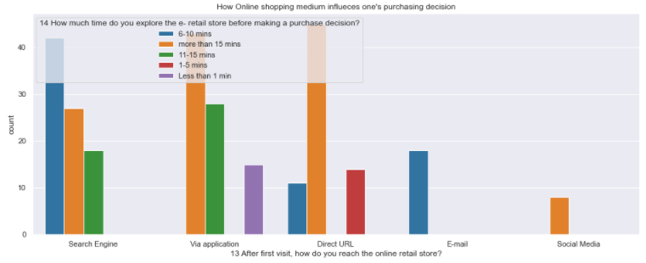
Relationship between channel and online store

Slide 14
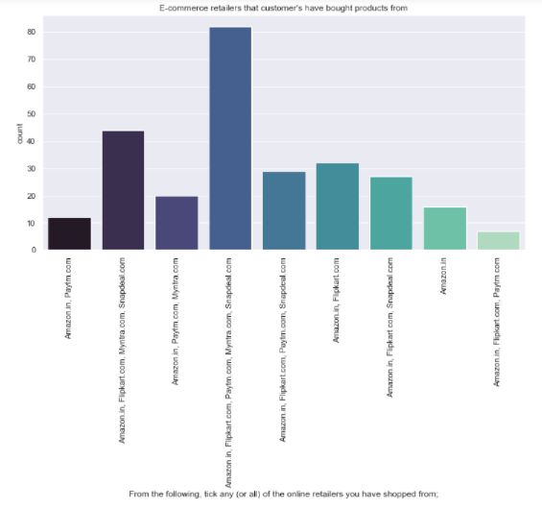
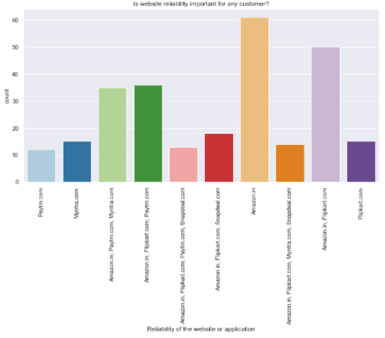
Preference of E-Commerce retailers Websites: Amazon, Flipkart, Paytm, Myntra ,Snapdeal are the most preferred online retailers.

Slide 15
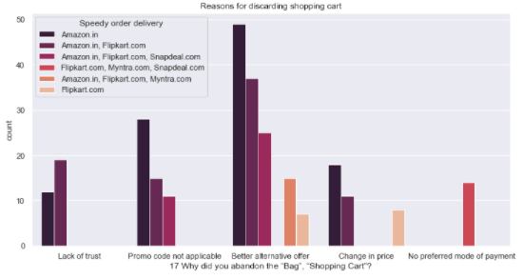

Majority of Indians prefer Amazon.in over other E-Commerce retailers. Purchasing satisfaction also because of good quality of website.
Five major factors that contributed to the success of an e-commerce store have been identified as:
Information quality
service quality
System quality
Trust
Net benefit.
Loyalty

Slide 16
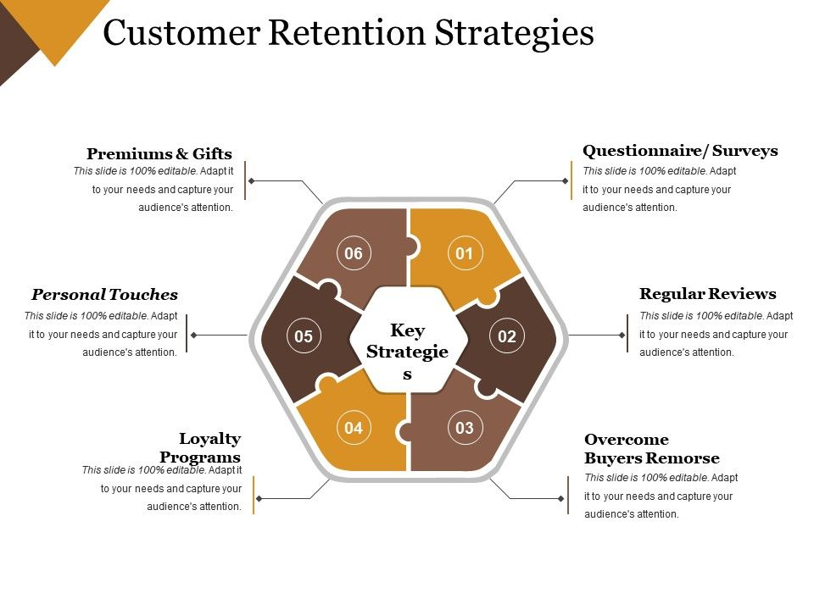
Lifetime Value
.
.

Slide 17

What is lifetime value?
Net present value of the profit to be realized on the average new customer during a given number of years.
To compute it, you must be able to track customers from year to year.
Main use: To evaluate strategy.

Slide 18


Customer satisfaction increases
Then success of store increases

Slide 19

If Customer satisfaction increases, then these increases:
Purchase/customer activation
Re-purchase Intention/Customer Retention
Customer Loyalty

Slide 20

Factors matters
User Friendly website/ Application
Flexibility
Ease of navigation in website
Time taken to log in
Payment methods
Delivery speed

Slide 21
Analysis
Most of the customers are females with age from 20-50 and they used mobile internet to access with Windows as operating system.
And most of the customers used search engines to get into the platform first time and frequently.
Max customers uses there debit/credit cards for there payment.
Almost customers has a expectation to have Content_Readability, Similar_ProductInfo, Seller_ProductInfo, ProductInfo_Clarity, Ease_Navigation, Loading_ProcessingSpeed, UserFriendly_Interface, Conveninet_PaymentMode, TimelyFulfilment_Trust, Customer_Empathy, CustPrivacy_Guarantee, VariousChannel_Responses, Benefit_Discount, Enjoy_OnlineShopping, Convenience_Flexibility, Returns_ReplacementPolicy, Loyalty_ProgramAccess, QualityInfo_Satisfaction, WebsiteQuality_Satisfaction, NetBenefit_Satisfaction, User_Trust, Product_SeveralCategory, Relevant_ProductInfo, Monetary_Savings, Patronizing_Convenience, Adventure_Sense, Enhances_SocialStatus, Gratification_Shopping, Role_Fulfilment, Money_Worthy in e-commerce websites.

Slide 22
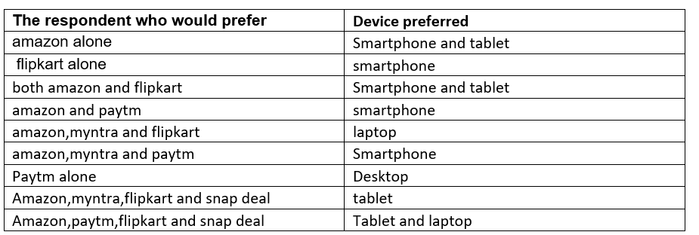
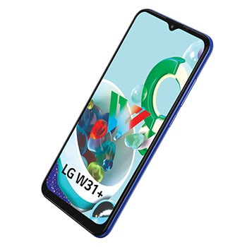
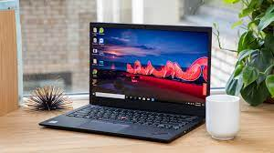
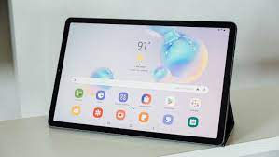
The system and device used by the costumer

Slide 23
Observations
Female customer often prefer to purchase more as compared to Male customer
People between 21 to 50 years of age tends shops more.
Dataset appears to have approximately 67% of Female respondents & 32 % of Male
Delhi has maximum count which means in Delhi the online purchase is high.
Mobile screen size has maximum count for others,and 2nd most count is for 5.5 which is the most used screen size.
Customers with OS windows/windows mobile are more in number,as it's the most common OS.
Most of the customers uses chrome browser, which seems to be best in market and easy to use.
Most of the customers used Search engine to reach there favorite online store for the first time , as search engine shows variety of similar product from n-number of sites.
After first visit most of the customers are reaching the online store through Search engine, Via application and Direct Url.
Most of the customers are exploring the e-retail store more than 6 mins before making purchase decision (checking all info and deciding which one to buy usually take time).
Maximum customers are using credit/debit cards for there payment(most convenient and easy to use).
Amazon and flipkart is performing best in all given parameter

Slide 24
Conclusion
After the detailed analysis of problem I found the following conclusions:
Frequency of Females shoping is high so making them satisfied will help the sellers to get more business.
Loyal customers prefer buying and tend to spend more money on shopping in your store. Statistics show that engaged consumers purchase more frequently. It is necessary to hear customer feedback because most of them are valuable feedbacks.
Sometimes customer feedback is the best marketing strategy. They are frequent customers so they will know which areas of your business may well be improved. If their feedback is approved, they will extremely excite and support your company with their best ability.
It found that Amazon and Flipkart are standing best out in the market by using ethical, reasonable business strategies
The repeat purchase intention (loyalty) positively, Structural equation model has been presented on the primary data collected from the Indian online shoppers.
Here as an conclusion part I found that using dead old strategies for retailers will effect customer retention.

Slide 25

.
.
Presented by:
Deepak singh

